Slide 1

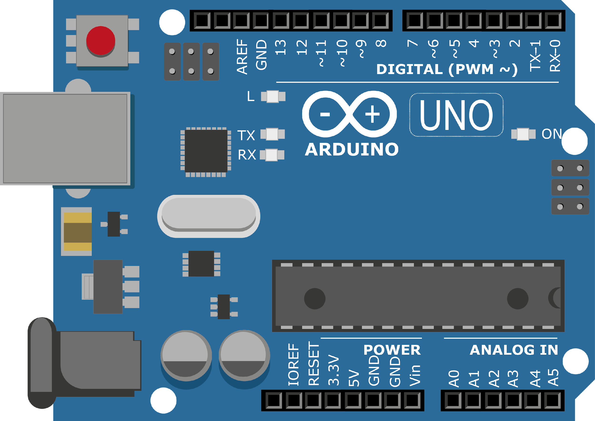
ARDUINO MASTER CLASS
19
Water quality detection using PH Sensor

Slide 2
19 AGENDA
02
03
01
Split
Functions
PH Sensor
Water quality measurement

Slide 3
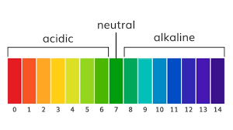
PH Value
In chemistry, pH - 'potential of hydrogen' or 'power of hydrogen') is a scale used to specify the acidity or basicity of an aqueous solution. Acidic solutions (solutions with higher concentrations of H+ ions) are measured to have lower pH values than basic or alkaline solutions.

Slide 4
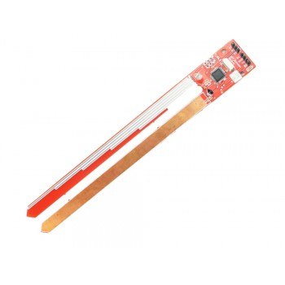
PH Sensor
This PH rod is designed on ATMEGA8.
On board LDR for light value, Thermistor for temperature value.
It gives Serial data at its Tx pin
PH value W: depth of rod immersed L : light value T temperature value
PH W L T

Slide 5
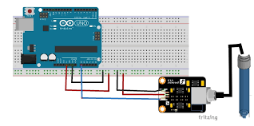
PH sensor with Arduino

Slide 6
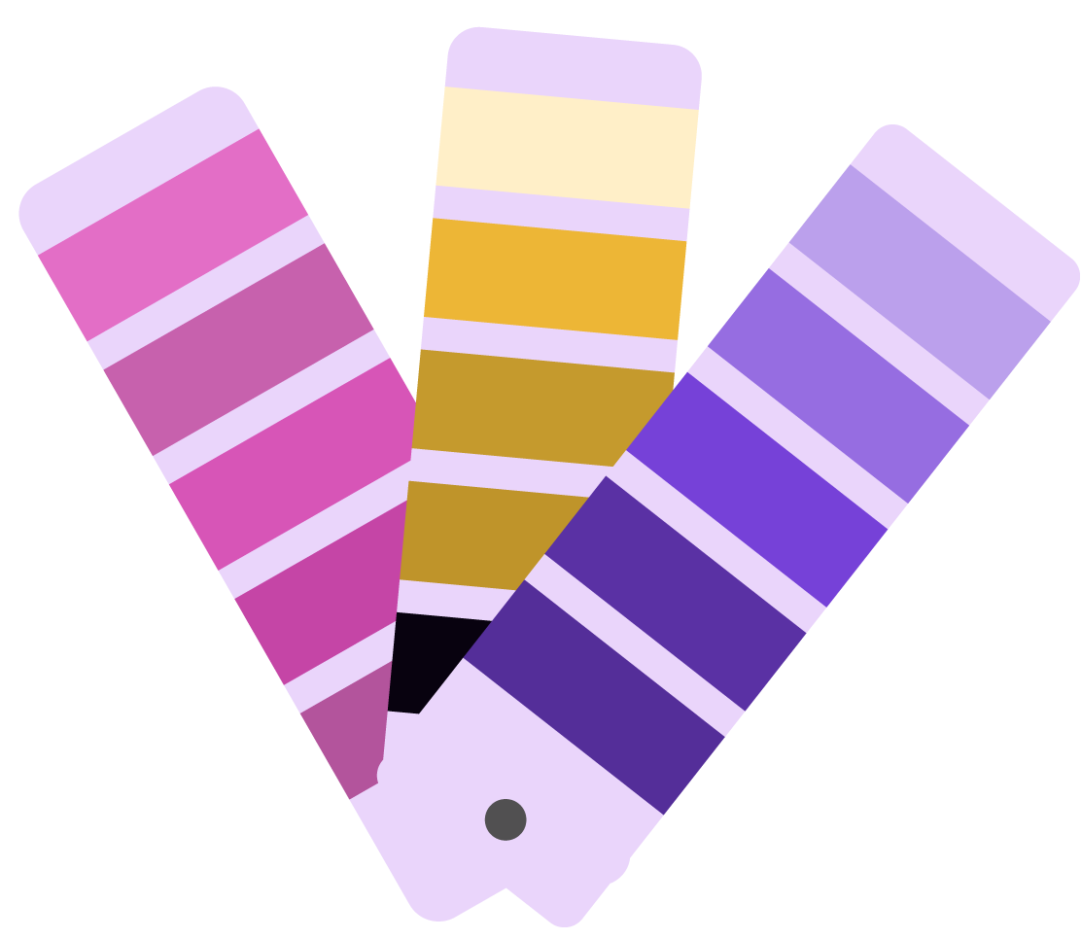
INTERVIEW QUESTIONS
Universal gate?
Latches vs Flipflop
Karnaugh Map
latches are level triggered and flip-flops are edge triggered. In latches level triggered means that the output of the latches changes as we change the input and edge triggered means that control signal only changes its state when goes from low to high or high to low.
Latches are fast whereas flip-flop is slow.
The Universal gates are NAND and NOR. The advantages of these gates are that they can be used for any logic calculation.
Karnaugh maps reduce logic functions more quickly and easily compared to Boolean algebra. By reduce we mean simplify, reducing the number of gates and inputs.

Slide 7

THANKS!

